Slide 1


Models for Security Testing
in the Software Development Lifecycle
Ryan Berg, Chief Scientist, Ounce Labs

Slide 2
Why are we here ?
I had some time to fill and this topic looked interesting
Application security is the latest <insert newest internet related buzzword here>
Heard there was free food
Don’t need a reason since you are still getting paid
The “monster at the end of the book”

Slide 3
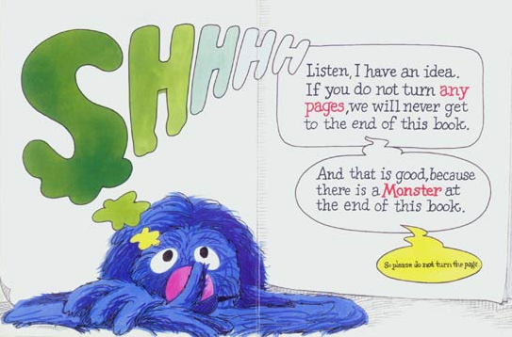
The Monster at the End of the Book

Slide 4
More seriously…
How to bring practicality or (reality) into secure software development
WWWWWH (Pronounced WWWWWH)
  (W)hy – Why do anything at all?
  (W)hat – What should/can I do differently?
  (W)hen – Sounds like a lot of work, when should I do all of this?
  (W)ho – Who are the key stakeholders?
  (W)here – Where in the SDLC does this get implemented?
  (H)ow – My brain hurts, how can we ever get this done?

Slide 5
Why?
HTTP
  The security industry has evolved as the attack landscape has changed
  It used to be all about the network, now it’s all about the applications
Who really wants to be the next headline?
The Feds are coming, the Feds are coming!
  FISMA, Sarbanes Oxley, PCI, BASEL II, Gramm-Leach-Bliley Act, HIPAA, ISO 17799
What we are doing isn’t working!
Notes:
Application security is still built around the ‘hard crunchy outside’ philosophy – but we are still finding that these applications have that same insecurity – if you put barriers around the outside but still have external services and protocols that allow traffic in and have access to everything. You have to treat all data in a secure manner!
‘Buffer overflow” the commodity word of the last decade, “SQL injection” is the commodity word now.
Evolution of regulation – a decade ago for HIPAA etc., regulations were kind of general, but more and more we’re seeing industry regulations like PCI get more and more specific about addressing security at the application layer.

Slide 6
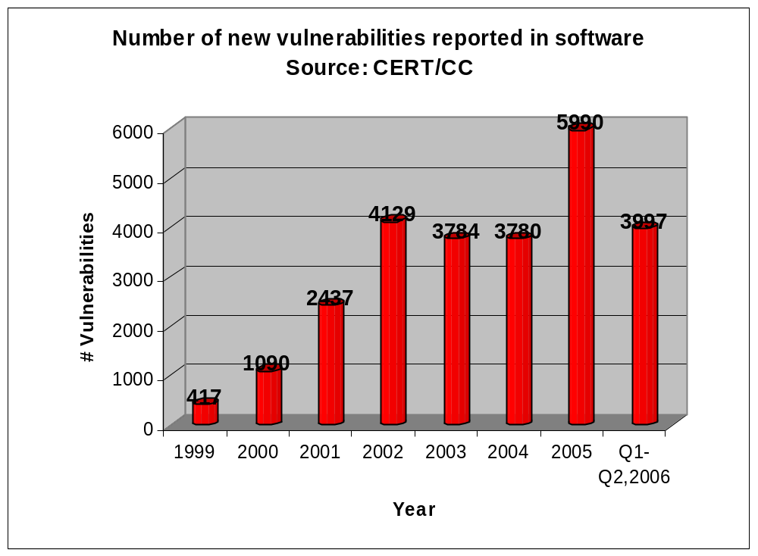
Trends in vulnerabilities…
Notes:
The graph shows the number of new vulnerabilities reported in software doubling yearly from 1999 to 2002. In 2002 the biggest names in the commercial software development industry—companies like Microsoft, IBM and CISCO— shifted the way they were building software in response to the need for security. They began pushing security into all stages of the development lifecycle, and books emerged such as Howard and LeBlanc’s Writing Secure Code that finally offered a roadmap for developers to make more secure software. This security push by the large vendors ignited an industry-wide awareness of security that had immediate impact in rapid production environments such as e-commerce sites and thus lowering the number of new vulnerabilities reported. The expectation is that this trend will continue to be felt as old products are replaced with newer versions that have had the benefit of this paradigm shift. Corporations, governments and vendors have begun to realize that we need to look at software bugs, requirements and development differently to adapt to the new security-savvy consumer. This puts the pressure on software developers and testers to take personal responsibility for security.
Trending up – tools available to the casual hacker, real money being made in discovering vulnerabilities. Legitimized crime organizations seeking to steal identities and are feeding this industry.

Slide 7



Who really wants to be the next headline?
Headlines | Cost | Design Flaw
 | $ 3.7 M To upgrade laptops | Failure to encrypt sensitive information
 | $ 13 M Claims & Suits | Lack of encryption Inappropriate storage Weak access control
 | $ 15 M FTC Fines | Failure to authenticate users
 | $ 6 – 9 M | Inappropriate storage Storage in unencrypted files Inappropriate Network communications
 | CardSystems went out of business | Inappropriate storage Inappropriate Network communications
Veterans Angered by
File Scandal
BJ's Settles Case with
FTC Over Customer Data
ChoicePoint to Pay $15M
over Data Breach
1.4 million records stolen
from retailer
Visa, Amex Cut Ties With Card Processor

Slide 8
What?
What’s being done isn’t working
Security isn’t always included
  Software Engineer vs. Software Security Engineer
  Coding guidelines vs. secure coding guidelines
“Build Security In” – sounds deceptively simple
Policy is not a four letter word
Have a plan before you need one
Notes:
One only has to look at the latest headlines to know that what is being done currently isn’t working
Software Engineer or Software Security Engineer, is there a difference? Should there be?
Build Security In – sounds simple but can require process change.
Many organizations have coding guidelines, but do you have secure coding guidelines?
Policy is not a four letter word.
Have a plan before you need one.

Slide 9
Where?
Baking security into requirements: gathering security requirements/needs, abuse cases, and threat modeling
Baking security into design: security design patterns, security reviews and threat modeling
Baking security into development: secure coding guidelines, tools, and audit
Baking security into testing: negative testing, thinking like the bad guy and “red teams”
Baking security into deployment: secure deployment guidelines, secure update mechanisms (patching) and much, much more!

Slide 10
Who?
Development Management
Corporate Security
Audit and Compliance
Quality Assurance
Software Development

Slide 11
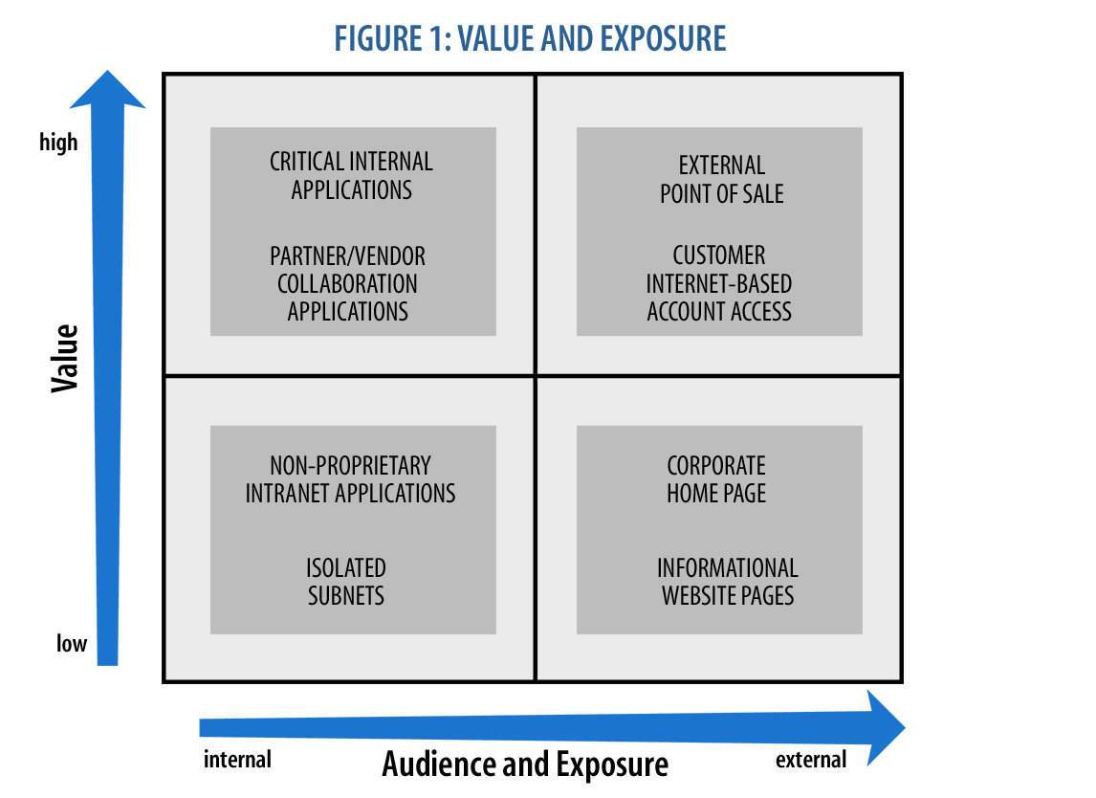
When?
As often as is practical
  Prioritize the most critical applications
  Separate legacy from new development
  Customer facing vs. internal
Notes:
(don’t de-emphasize internal too much as it’s often one request away from being made external)

Slide 12
How - Objectives for Practical Security
  Improve existing development process, not create new one
  Maximize security impact of personnel and technologies
  Use models as initial framework and tailor to individual organization
  Select model with consideration for future requirements

Slide 13
Potential Obstacles
Fiction
Security/Development gap cannot be bridged

Slide 14
Potential Obstacles
Fiction
Fact
Security/Development gap cannot be bridged
Management support and mutual goals reduce gap

Slide 15
Potential Obstacles
Fiction
Fact
Security/Development gap cannot be bridged
Aggressive release schedule doesn’t allow for security testing
Management support and mutual goals reduce gap

Slide 16
Potential Obstacles
Fiction
Fact
Security/Development gap cannot be bridged
Aggressive release schedule doesn’t allow for security testing
Management support and mutual goals reduce gap
Long-term efficiency created by reducing maintenance and patch costs

Slide 17
Potential Obstacles
Fiction
Fact
Security/Development gap cannot be bridged
Aggressive release schedule doesn’t allow for security testing
Peer review sufficiently addresses security issues
Management support and mutual goals reduce gap
Long-term efficiency created by reducing maintenance and patch costs

Slide 18
Potential Obstacles
Fiction
Fact
Security/Development gap cannot be bridged
Aggressive release schedule doesn’t allow for security testing
Peer review sufficiently addresses security issues
Management support and mutual goals reduce gap
Long-term efficiency created by reducing maintenance and patch costs
Peer review is ineffective as security measure

Slide 19
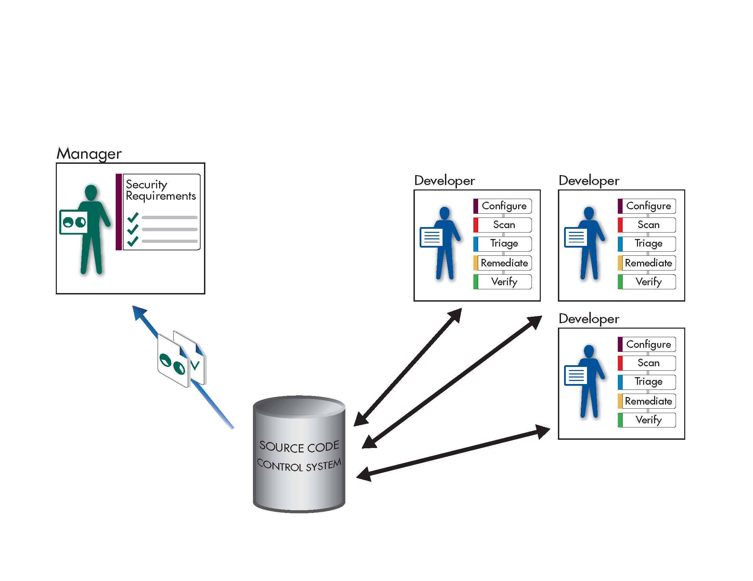
Core Responsibilities
Set security requirements: A manager or security expert defines vulnerabilities and how to judge criticality
Configure analysis: The source code analysis tool is customized to address internal policies.
Scan source code: The analysis tool is run against the target application to pinpoint vulnerabilities.
Triage results: Security-minded staff study results to prioritize remediation workflow.
Remediate flaws: Vulnerabilities are eliminated by rewriting code, removing flaws, or adding security functions.
Verify fixes: The code is rescanned to assure vulnerabilities are eliminated.

Slide 20
Model I: Independent
Managers
  Define security requirements
  Review development progress reports
Developers
  Check out source code under development
  Add/modify existing application
  Configure scanner for analysis
  Run scan on entire application
  Perform necessary triage
  Remediate reported vulnerabilities
  Run scan to verify vulnerability fix
  Check in latest code changes

Slide 21
Model I: Independent
Benefits
  Developer-only implementation
  Low initial investment
Challenges
  Scalability
  Redundancy of work
  Reporting/tracking progress
  Enforcing policy
  Expertise requirements

Slide 22
Model I: Independent
Benefits
  Developer-only implementation
  Low initial investment
Challenges
  Scalability
  Redundancy of work
  Reporting/tracking progress
  Enforcing policy
  Expertise requirements
Best Practices
  Establish centralized security requirements
  Conduct security reviews among developers
  Establish a security-capable developer as a mentor

Slide 23
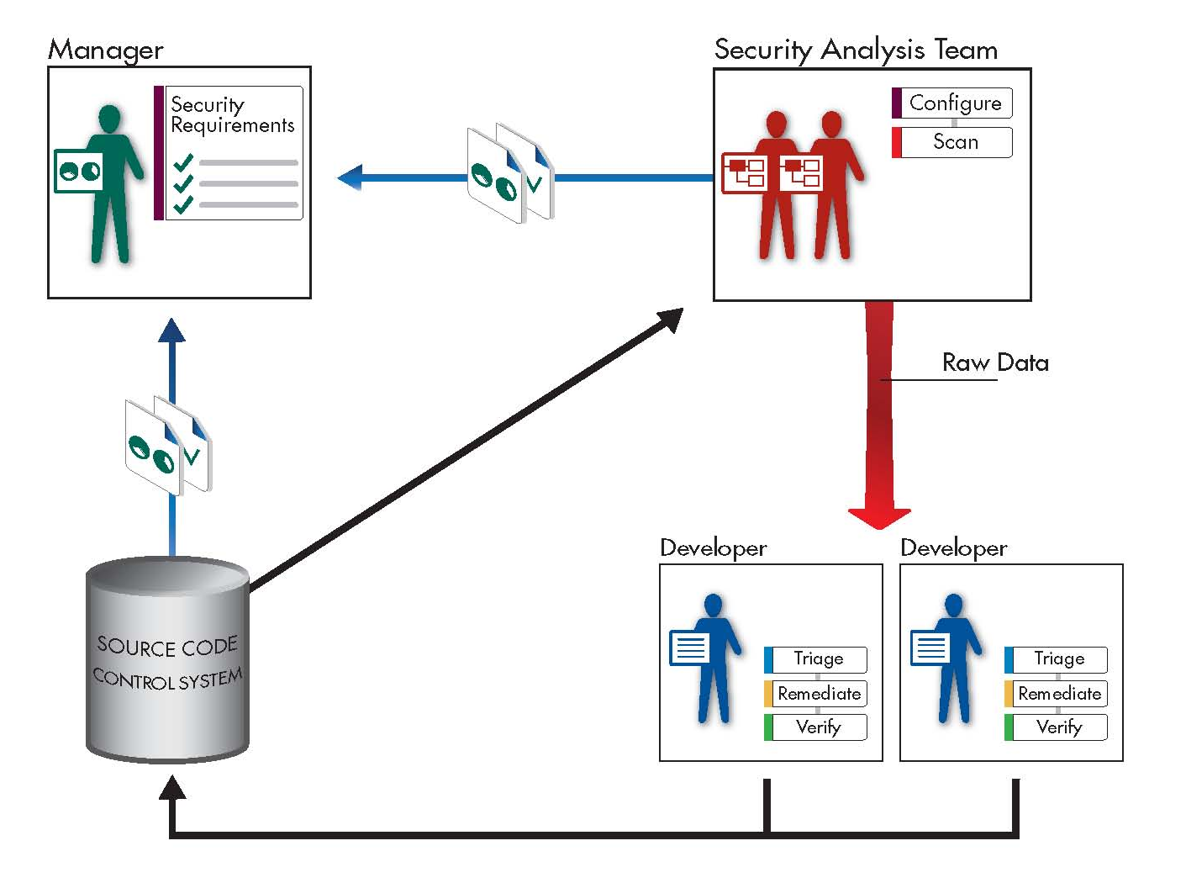
Model II: Distributed
QA/Release Engineer Team
  Configure scanner for build integration
  Sync code at each milestone
  Scan entire app with new milestone components
  Provide raw data to development
QA/Release Engineer Team
Managers
  Define security requirements
  Track development progress and review assessment data
Developers
  Triage analysis results
  Perform necessary remediation
  Verify fixes before checking code back in

Slide 24
Model II: Distributed
QA/Release Engineer Team
Benefits
  Deployment flexibility
  Integration with build environment
  Policy enforcement
  Central reporting
Challenges
  Scalability
  Redundancy of work
  Expertise requirements

Slide 25
Model II: Distributed
Benefits
  Deployment flexibility
  Integration with build environment
  Policy enforcement
  Central reporting
Best Practices
  Scan early in life cycle
  Assign developers specific components to review
  Establish a security-capable developer as a mentor
Challenges
  Scalability
  Redundancy of work
  Expertise requirements

Slide 26
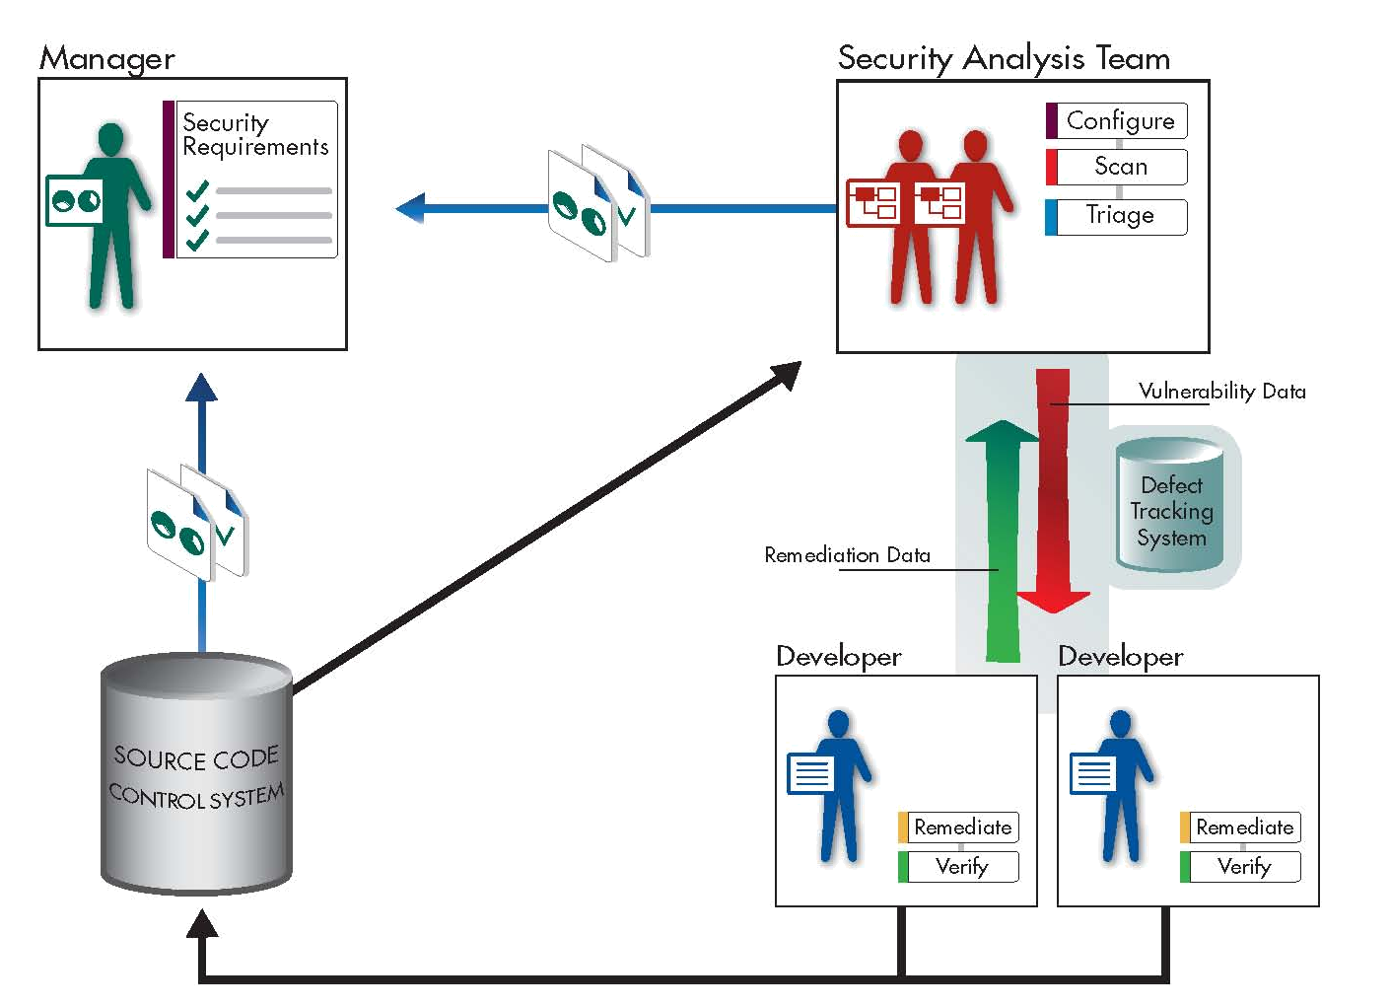
Model III: Centralized
Security Analysis Team
  Configure scanner for build integration
  Retrieve code for analysis
  Scan entire application
  Triage results
  Assign vulnerabilities to developers
Managers
  Define security requirements
  Track development progress, review vulnerability data, and monitor remediation results
Developers
  Perform necessary remediation
  Check in code

Slide 27
Model III: Centralized
Benefits
  Deployment flexibility
  Separation of duties
  Central management
  Long-term value
Challenges
  Resource requirements
  High-level commitment

Slide 28
Model III: Centralized
Benefits
  Deployment flexibility
  Separation of duties
  Central management
  Long-term value
Challenges
  Resource requirements
  High-level commitment
Best Practices
  Plan process with development and security
  Focus on training and guidance for security team
  Integrate with existing technologies

Slide 29
Which is right for you?
Benefits | Independent Model | Distributed Model | Centralized Model
Effectively reduces security vulnerabilities | ✓⁻ | ✓ | ✓⁺
Centralized management and remediation strategy |  | ✓ | ✓⁺
Centralized analysis configuration |  | ✓ | ✓
Cross-enterprise reporting of results and progress |  | ✓ | ✓⁺
Supports distributed development teams | ✓⁻ | ✓ | ✓
Supports small development and audit projects | ✓⁺
Prioritized remediation assigned to developers |  |  | ✓
Low level of management commitement | ✓
Scales to large applications and development teams |  | ✓ | ✓⁺

Slide 30
For more information
To learn more about implementing source code vulnerability analysis…
Download: Secure at the Source:
Implementing Source Code Vulnerability Testing
in the Software Development Lifecycle
  Supporting research
  Details on deploying each model
  Case examples
Visit: www.ouncelabs.com
  Product information
  Extensive industry research and technical documents
  Register for free code audit

Slide 31
Questions & Answers
Ryan Berg
Chief Scientist
Ounce Labs, Inc.
www.ouncelabs.com

